Slide 1

REAL-TIME FOREST FIRE DETECTION USING EDGE-DRIVEN COLLABORATIVE UAV SWARMS
Sashwaat Fomra - CB.EN.U4CSE22352
Ayush Vachhani - CB.EN.U4CSE22406
Mugunth Narayanan R B - CB.EN.U4CSE22422

Slide 2

PROBLEM STATEMENT:
1) Forest Fires: A Growing Threat
Rapidly spreading wildfires endanger biodiversity, climate stability, and human settlements.
Challenges: Early detection is crucial but difficult in vast, dense forests, battery efficiency is vital
2) Limitations of Existing Fire Detection Methods:
Satellite imagery:
Delayed updates
Limited spatial and temporal resolution.
Affected by cloud cover and smoke.
Ground-based sensors:
Fixed locations result in limited coverage.
Ineffective in remote or inaccessible areas.
Performance degrades in extreme weather conditions

Slide 3

Problem Definition:
The goal of our system is to detect forest fires as early as possible using a swarm of UAVs that collaborate to validate fire locations while minimizing false alarms. The UAV Swarms should autonomously navigate to the search area, detect fire regions, share information with their neighbors, and reach a consensus before flagging a fire event.

Slide 4

Challenges and Considerations:
Large Search Area: Forest fires can ignite in vast and remote areas, requiring an efficient search strategy that balances exploration and coverage.
Dynamic Environmental Conditions: Wind, temperature variations, and smoke affect UAV sensors and require adaptive decision-making.
False Alarms: False positives (e.g., sunlight reflections, hot rocks) and false negatives (e.g., hidden fire under the canopy) must be minimized through collaborative verification.
Communication Constraints: UAVs should be able to operate even with intermittent connectivity, relying on local peer-to-peer information exchange.
Energy Efficiency: UAVs have limited battery life, requiring optimized flight paths and minimal redundant scanning.

Slide 5
WHY EDGE COMPUTING?
Cloud-based fire detection relies on transmitting large volumes of sensor data to remote servers, leading to high latency. This delay is critical in forest fires, where early intervention is necessary to prevent rapid fire spread.
Dense forests and mountainous terrains often lack reliable internet infrastructure. Without stable connectivity, UAVs and ground sensors cannot continuously transmit data to the cloud, making cloud-based fire detection impractical.
Satellite imagery can be obstructed by cloud cover, dense smoke, and weather conditions, delaying fire detection
Edge computing solves this by processing data locally on sensors, drones, or edge devices, enabling real-time detection, reduced bandwidth consumption, and offline operation.

Slide 6
LITERATURE SURVEY:
1)”SOScheduler: Toward Proactive and Adaptive Wildfire Suppression via Multi-UAV Collaborative Scheduling”
Link: https://ieeexplore.ieee.org/document/10502270
Spatio-Temporal Confidence-Aware Model: Dynamically identifies optimal UAV positions for wildfire suppression based on real-time environmental conditions.
Priority-Based Scheduling: Uses a priority graph to efficiently coordinate multiple UAVs, optimizing resource allocation and response time.
2) “Adaptive Hierarchical Multi-Headed Convolutional Neural Network With Modified Convolutional Block Attention for Aerial Forest Fire Detection”
Link: https://ieeexplore.ieee.org/document/10818623
Uses a multi-headed CNN with CBAM to improve fire detection accuracy.
Enhances spatial feature extraction for precise aerial monitoring.

Slide 7
3)”Nature-Inspired Drone Swarming for Wildfires Suppression Considering Distributed Fire Spots and Energy Consumption”
Link: https://ieeexplore.ieee.org/document/10132476
Proposes a swarm intelligence approach for decentralized wildfire suppression.
Drones communicate locally to optimize fire response and manage energy efficiently.
4)”Neural Network Methods for Detecting Wild Forest Fires”
Link:https://link.springer.com/article/10.3103/S0147688224700412
Reviews various neural network based techniques for fire detection from UAV video feeds.
Covers feature extraction and semantic segmentation.
5)”Application Strategy of Unmanned Aerial Vehicle Swarms in Forest Fire Detection Based on the Fusion of Particle Swarm Optimization and Artificial Bee Colony Algorithm”
Link: https://www.mdpi.com/2076-3417/14/11/4937
Combines Particle Swarm Optimization (PSO) and Artificial Bee Colony (ABC) algorithms for efficient UAV swarm deployment.
Enhances fire detection accuracy and UAV path optimization.

Slide 8


RESEARCH GAP:
Delayed Detection:
Satellites: Slow updates due to orbital schedules & cloud cover.
Ground Sensors: Limited coverage in remote areas.
Limitations of Single-UAV Systems:
Restricted coverage, slower response times.
High false positives & negatives (e.g., reflections, dense canopies).
Navigation challenges in dynamic environments.
Lack of UAV Collaboration:
No real-time data sharing, leading to false alarms.
No swarm-based decision-making for improved accuracy.
Energy & Communication Issues:
Short battery life, requiring optimized flight paths.
Signal interference in forested terrain.

Slide 9
Limitations Of Existing Models:
Uniform-DFC
Working: Employs a uniform random walk during the search phase, followed by Dynamic Formation Control (DFC) for fire mitigation by equally dividing the fire region among UAVs.
Limitation: The method suffers from inefficient area coverage and delayed detection due to lack of directional guidance or environmental adaptability.
Normal-DFC
Working: Uses a Gaussian-distributed search pattern to bias UAV exploration towards central regions, improving search focus compared to uniform random walk.
Limitation: Fails to dynamically adapt to environmental changes like heat gradients or fire spread, limiting responsiveness.
Levy-DFC
Working: Incorporates Levy flight-based search, enabling UAVs to perform a mix of local exploration and long-range jumps for better coverage of sparse regions.
Limitation: Lacks environmental awareness during search and does not fine-tune UAV movement near detected fire zones.
OMS-DFC
Working: Introduces a multi-level stochastic search inspired by Oxyrrhis Marina, switching between Levy flight, Brownian motion, and Directionally Driven Brownian (DDB) based on temperature changes, combined with decentralized formation control for fire mitigation.
Limitation: Assumes ideal sensor behavior and does not incorporate multi-swarm coordination or dynamic role reassignment among UAVs, affecting scalability and robustness.

Slide 10


MAIN CONTRIBUTION:
AN EDGE-BASED ARCHITECTURE FOR RELIABLE FOREST FIRE DETECTION USING UAV SWARMS IS PROPOSED.
A NOVEL CONSENSUS-BASED DSI-LNN ALGORITHM WHICH IS BUILT UPON THE MSCIDC ALGORITHM ENHANCES DETECTION ACCURACY .
A COLLABORATIVE UAV ALGORITHM (USING LNN) DETECTS AND CONFIRMS FIRES USING CAMERAS, THERMAL IMAGING, AND TEMPERATURE SENSORS .
THE PROPOSED ALGORITHM IS VALIDATED AND TESTED FOR MEAN DETECTION TIME, MEAN MISSION TIME, AND FIRE EXPANSION RATIO (FER).

Slide 11

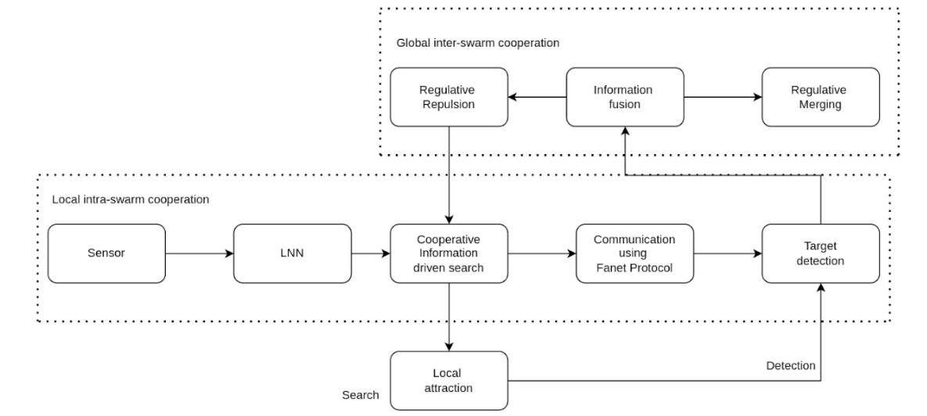
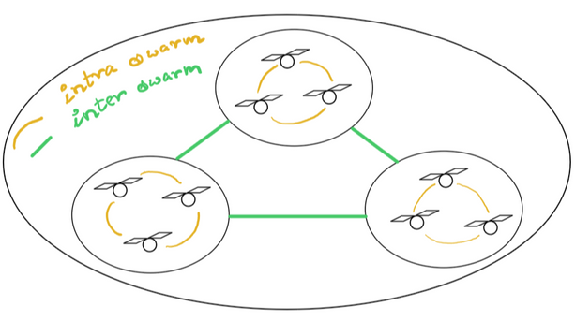
PROPOSED ARCHITECTURE:
Sensors -thermal sensor and optical imaging sensor

Slide 12
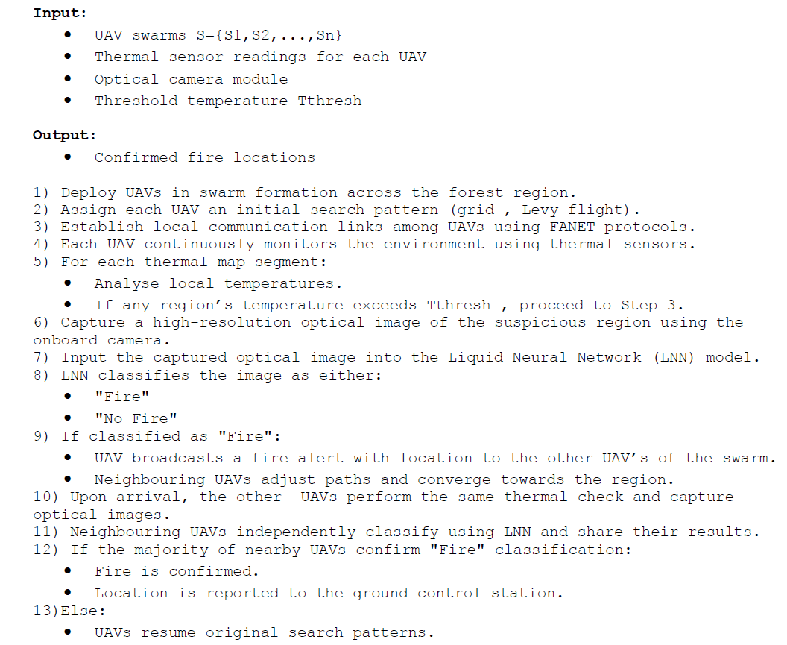
DSI-LNN ALGORITHM

Slide 13

Methodology:
Collaborative Search:
UAVs explore using predefined patterns (grid search, Levy flight).
Equipped with thermal & optical sensors for fire detection.
Continuously share sensor data with nearby UAVs.
Cooperative Fire Detection:
UAVs use Liquid Neural Networks (LNNs) to classify fire presence.
Detections are validated by neighboring UAVs to reduce false alarms.
Consensus-based decision-making (majority voting, confidence scores).
Communication & Consensus:
UAVs share data locally to confirm detections.
A fire is flagged only if multiple UAVs confirm within a set time.
Uses distributed consensus to ensure accuracy and reliability.

Slide 14
SIMULATION SETUP:
SIMULATION ENVIRONMENT: MATLAB R2021A.
Environment: 10 km × 10 km area with 15 UAVs detecting & mitigating 5 fire locations (2 circular, 3 elliptical).
Swarm Configuration:
15 UAVs divided into 7 swarms with sizes [3, 2, 2, 2, 2, 2, 2].
Flight Dynamics:
Search phase: Constant speed of 20 m/s.
Mitigation phase: Speed varies based on fire size.
Starting Positions: UAVs initiate the search from different locations within the area.
Performance Metrics:
Detection Time: Time to identify all fire locations.
Mission Time: Total time to detect & mitigate fires.
Fire Expansion Ratio (FER): Measures increase in burnt area post-mission.

Slide 15
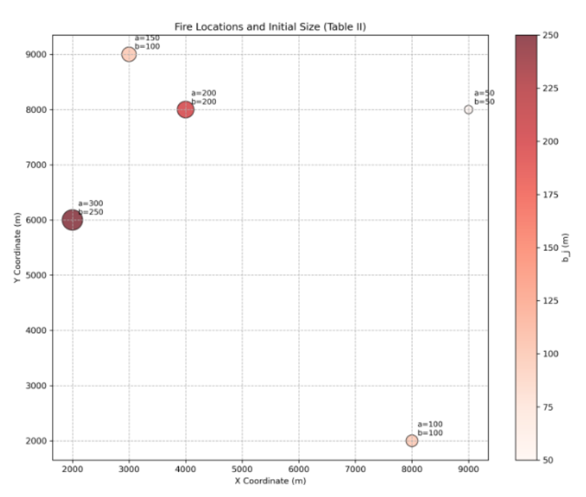
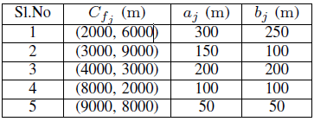
FIRE LOCATIONS AND INITIAL SIZE

Slide 16
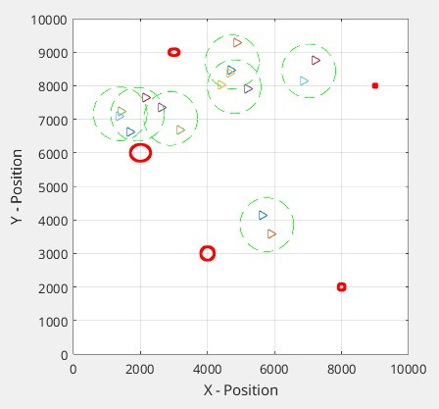
(a) All swarms performing collaborative detection of fire in their respective predefined locations:

Slide 17
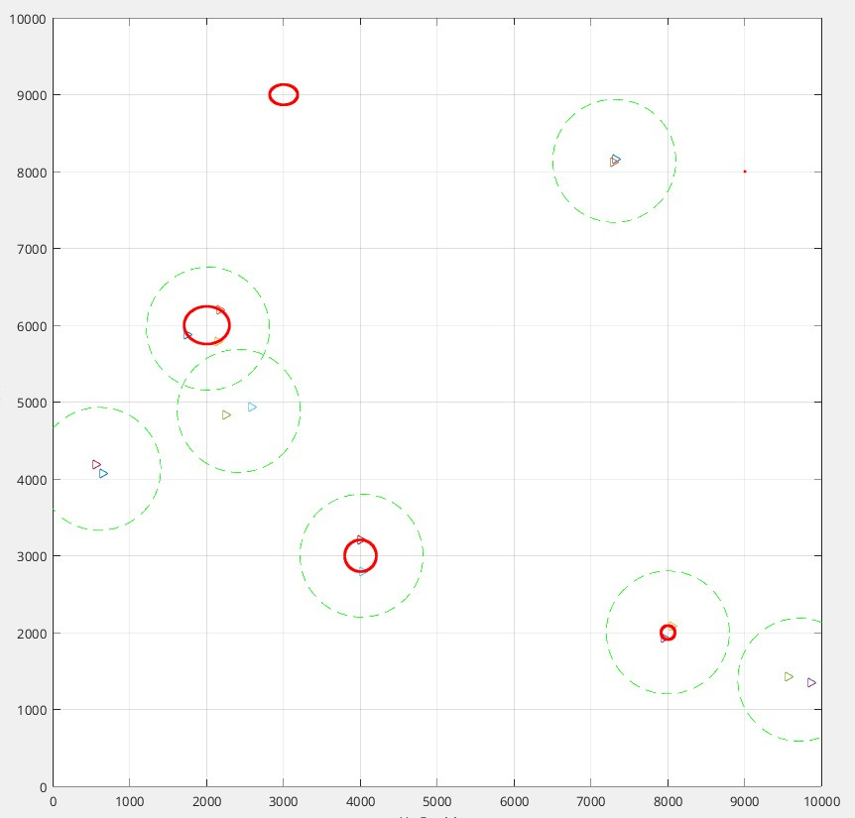
(b) Swarms detect fire and initiates local attraction

Slide 18
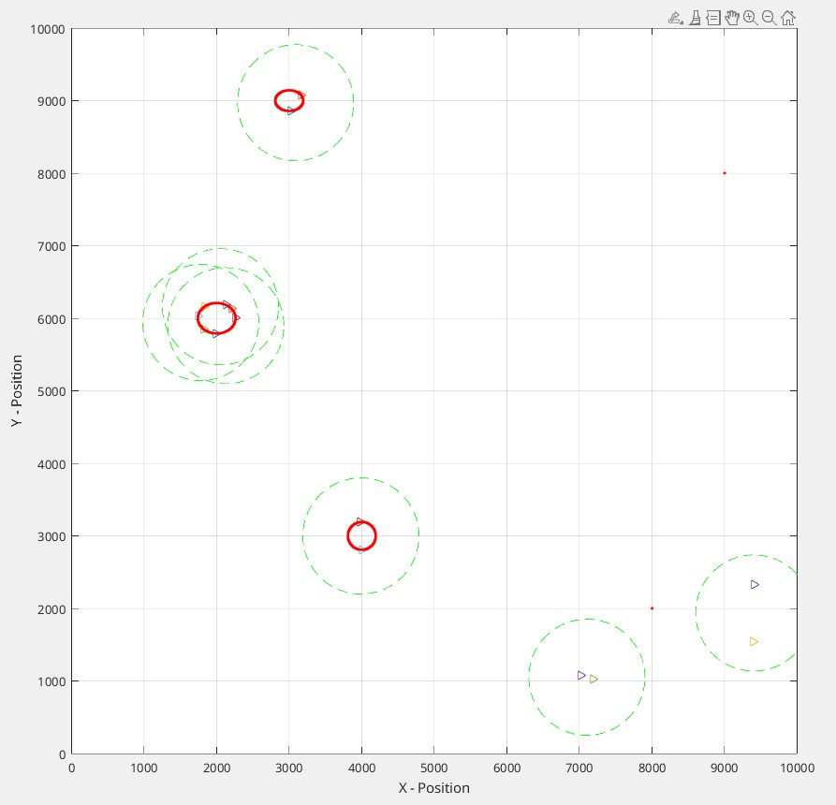
(c) Global regulative merging of swarms to the detected area

Slide 19
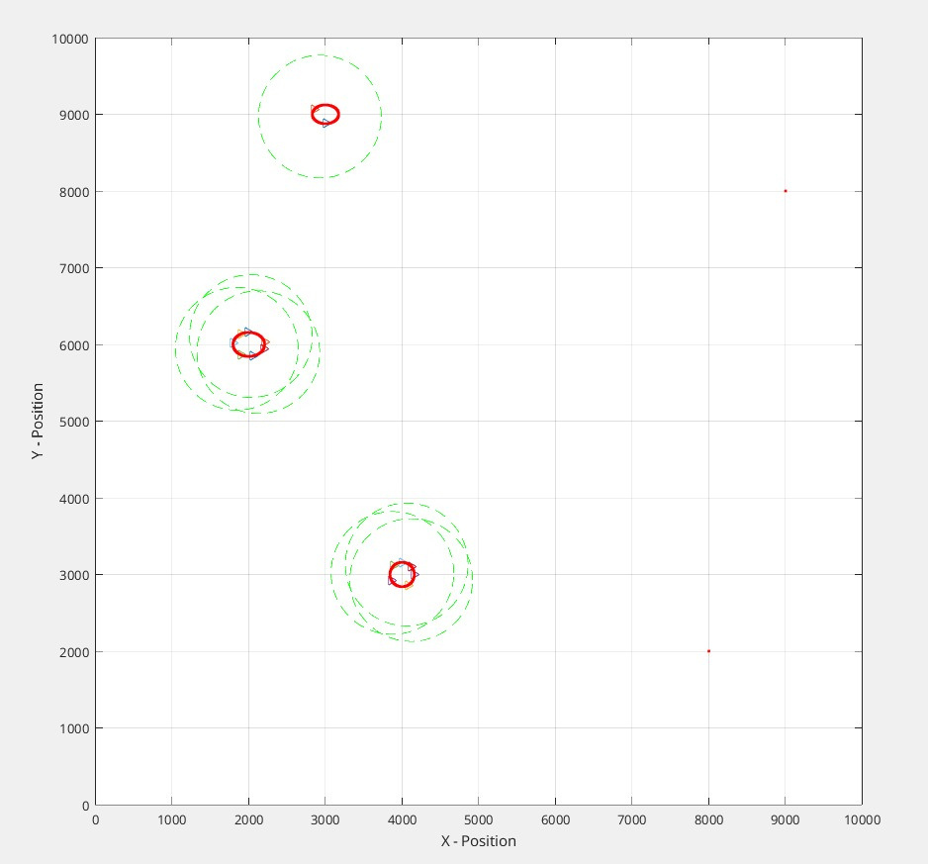
(d) All swarms merge to their respected fire detected areas to confirm the fire

Slide 20
Dataset : Forest Fire
Dataset Name: Forest Fire Dataset
Source: Kaggle - (https://www.kaggle.com/datasets/alik05/forest-fire-dataset)
Dataset Structure
Training Set:
fire/ → 760 images (Forest areas with fire)
nofire/ → 760 images (Forest areas without fire)
Testing Set:
380 images (Mixed fire & nofire images, filenames indicate labels)
No subfolders, images are named as fire_XXXX.jpg or nofire_XXXX.jpg
Image Properties
File Type: .jpg
Image Size: Varies (resized to 128x128 for model training)
Color Mode: RGB (3 channels)

Slide 21
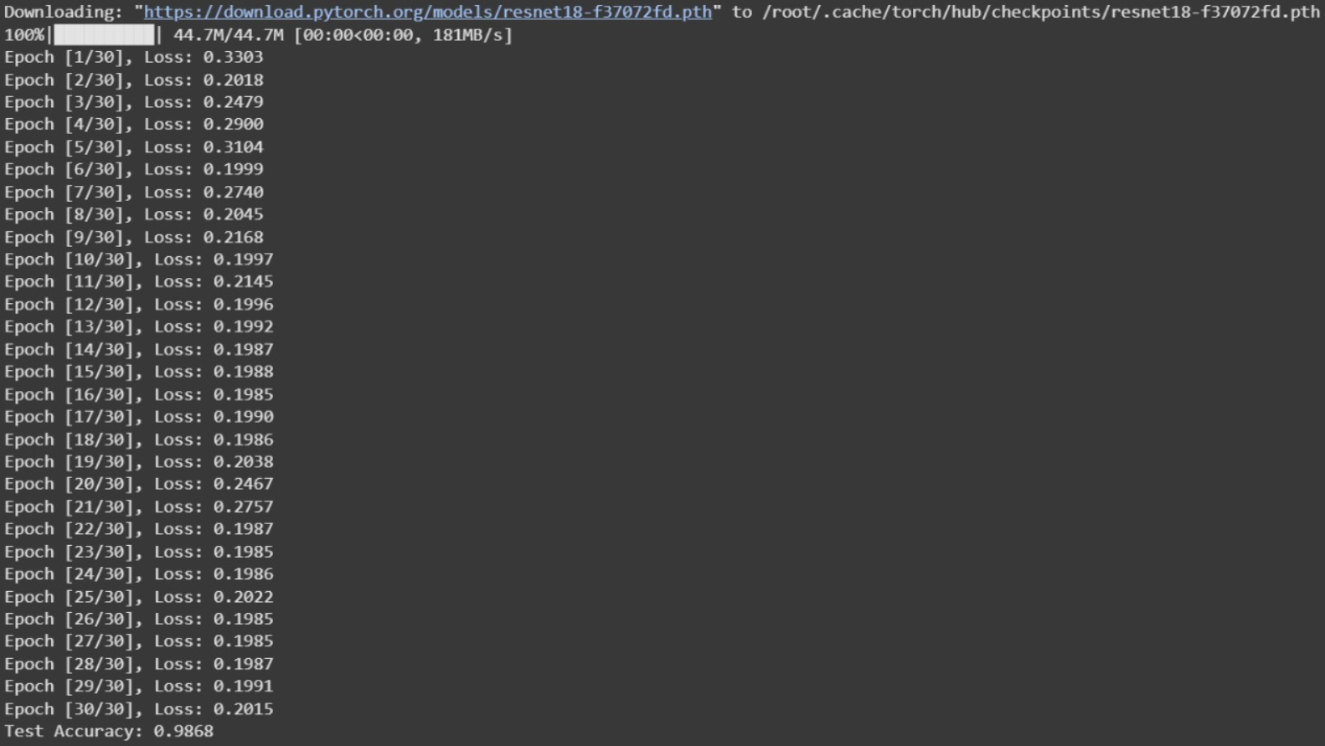
Training:

Slide 22
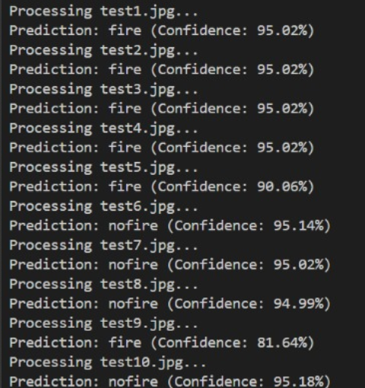
Testing:

Slide 23
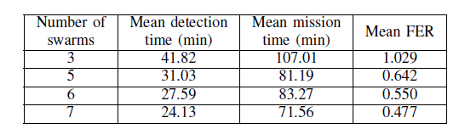
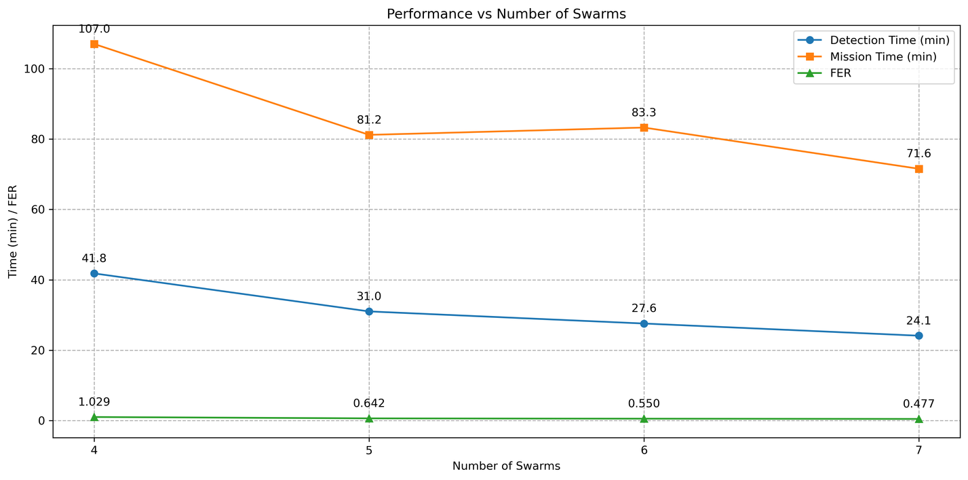
RESULTS:
1)Faster Detection & Mission Time:
Increasing swarms from 3 to 7 reduces detection time from 41.82 to 24.13 minutes and mission time from 107.01 to 71.56 minutes.
2)Better Fire Containment:
The Fire Expansion Ratio (FER) drops from 1.029 to 0.477, indicating improved fire containment with more swarms.

Slide 24
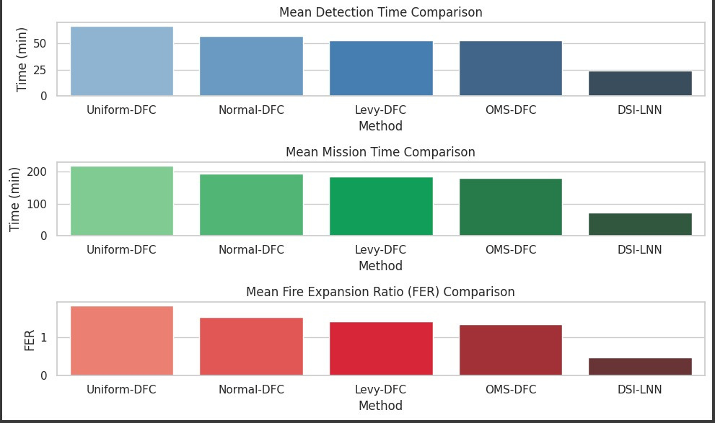
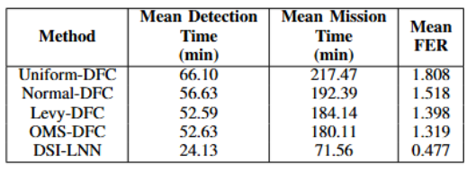
Performance Comparison:
Significant Improvement Over Traditional Methods:
The DSI-LNN method reduces mean detection time from 52.63 to 24.13 minutes, mission time from 180.11 to 71.56 minutes, and FER from 1.319 to 0.477, outperforming traditional approaches like OMS-DFC.
Enhanced Consistency & Efficiency:
The DSI-LNN cuts mission time by 60% and FER by 64%, providing faster fire detection and mitigation with significantly lower performance variability, ensuring more robust and consistent operations.

Slide 25
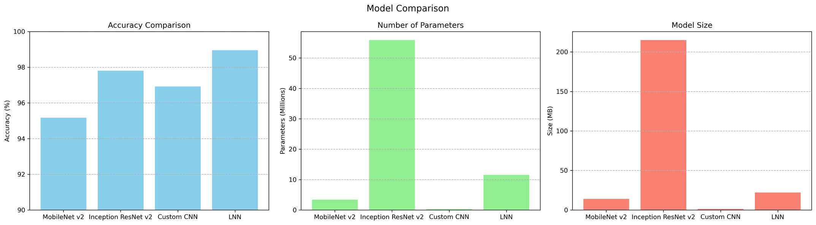
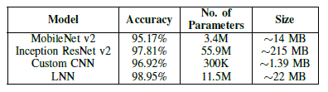
Comparison of Different Models For Validating Forest Fires
High Accuracy & Confidence:
The LNN model consistently achieves over 90% confidence in predictions, demonstrating exceptional accuracy of 98.95% in detecting fire or no-fire scenarios across multiple test images.
Fast & Reliable Performance:
LNN offers fast, reliable predictions, making it an ideal solution for real-time forest fire monitoring and early warnings.

Slide 26
RESULTS:
THE COLLABORATIVE UAV-BASED FIRE DETECTION SYSTEM IS TESTED IN A SIMULATED FOREST UNDER DYNAMIC CONDITIONS.
LIQUID NEURAL NETWORKS (LNNS) ENABLED REAL-TIME FIRE CLASSIFICATION, ADAPTING TO TEMPERATURE, HUMIDITY, AND WIND VARIATIONS.
LNNS IMPROVES EARLY DETECTION RATES AND PRIORITIZED HIGH-RISK AREAS, ENHANCING EFFICIENCY.
UAVS USES A REACTIVE FANET PROTOCOL FOR LOW-LATENCY, DECENTRALIZED COMMUNICATION AND COLLABORATION.
THE APPROACH SIGNIFICANTLY REDUCES FIRE DETECTION TIME COMPARED TO SINGLE-UAV METHODS.
SCALABLE AND ROBUST, MAKING IT SUITABLE FOR REAL-WORLD WILDFIRE DETECTION.

Slide 27
CONTRIBUTION:
Sashwaat
- Study and implementation existing search models (Uniform DFC, OMS DFC)
- Implementation of AODV FANET Protocol
- Implementation of custom CNN for fire validation
- Architecture of the DSI-LNN MODEL
- Implementation and optimisation DSI-LNN
Ayush
- Study of existing search models (Normal DFC)
- Implementation of BATMAN FANET Protocol
- Implementation of Inception ResNet v2 for fire validation
- Implementation and optimisation of DSI-LNN
Mugunth
- Study of existing search models (Levi DFC)
- Implementation of AODV FANET Protocol
- Implementation of MobileNet v2 , LNN
- Implementation and optimisation of DSI-LNN

